Slide 1
Flex Box
By Abby Cheng

Slide 2


Slide 3
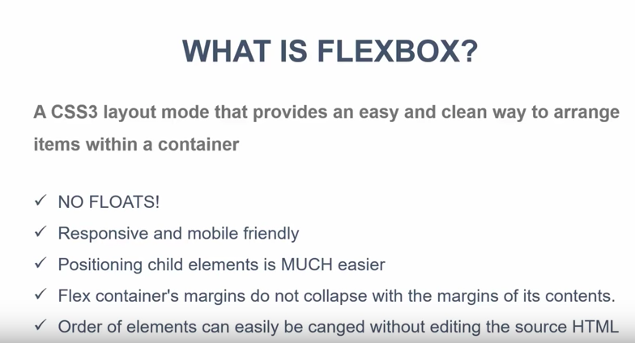

Slide 4
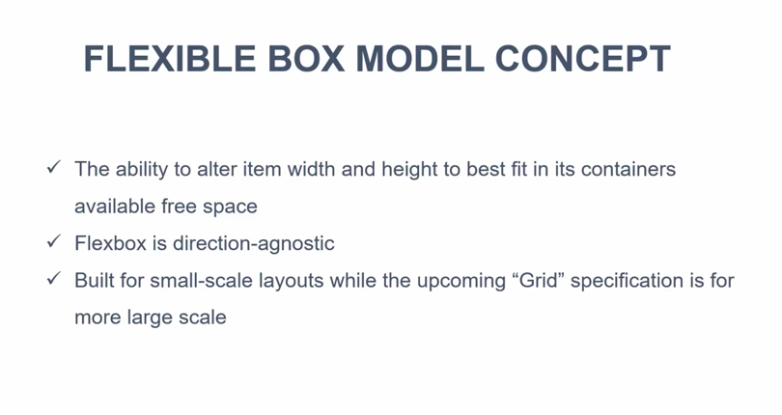

Slide 5
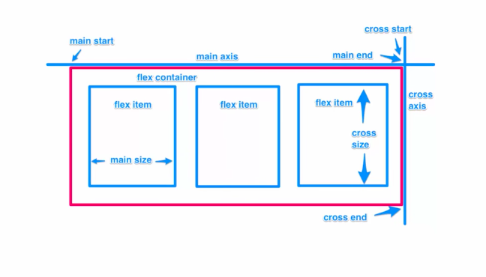

Slide 6
